Slide 1





DIGITAL TALENT SCHOLARSHIP
2019
digitalent.kominfo.go.id

Slide 2
Security
Nama pembicara dengan gelar

Slide 3
Security Overview (Tinjauan Keamanan)

Slide 4
Pembahasan
Pengantar keamanan AWS
Model AWS
Kontrol dan manajemen akses AWS
Program dan keamanan AWS

Slide 5
Pengantar Keamanan AWS

Slide 6
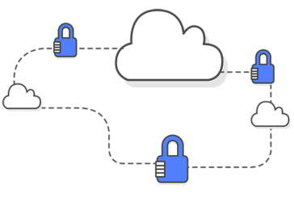
Pengantar Keamanan AWS
Keamanan adalah yang paling penting bagi AWS:
Pendekatan keamanan
Kontrol lingkungan AWS
Layanan dan fitur AWS
Notes:
Keamanan cloud di AWS merupakan prioritas tertinggi. Akan mendapatkan keuntungan dari pembuatan arsitektur jaringan dan pusat data untuk memenuhi kebutuhan organisasi yang paling memerlukan keamanan.

Slide 7

Mengamankan Data
Infrastruktur yang keras
Keamanan yang tinggi
Melindungi dengan baik
Notes:
infrastruktur tersebut terus dipantau untuk melindungi data
memberikan tingkat keamanan dan privasi yang lebih tinggi untuk layanan keamanan data
memantau layanan dan infrastruktur dasar untuk melindunginya dari ancaman, termasuk spam, perangkat lunak perusak, virus, dan bentuk-bentuk kode berbahaya lainnya.

Slide 8
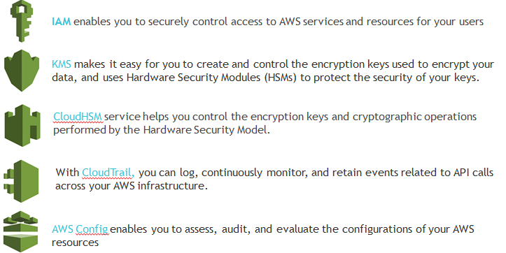
Layanan Keamanan AWS

Slide 9
Continual Improvement
Inovasi yang cepat
Layanan keamanan yang terus berkembang

Slide 10

Pengoptimalan Biaya
Sesuaikan ukuran layanan
mengatasi risiko yang muncul secara real-time
Memenuhi kebutuhan dengan biaya operasional yang lebih rendah.
Notes:
Opsi layanan dan harga AWS yang beragam menawarkan fleksibilitas untuk mengelola biaya secara efektif dan tetap mempertahankan kinerja dan kapasitas yang dibutuhkan.

Slide 11
Program kepatuhan AWS
Fitur:
Sertifikasi/Pengesahan
Undang-Undang/Regulasi/Privasi
Keselarasan/Kerangka Kerja
Notes:
Sertifikasi/Pengesahan:
Sertifikasi dan pengesahan kepatuhan dinilai oleh auditor independen pihak ketiga dan menghasilkan sertifikasi, laporan audit, atau pengesahan kepatuhan.
Undang-Undang/Regulasi/Privasi
Pelanggan AWS tetap bertanggung jawab untuk mematuhi hukum dan regulasi kepatuhan yang berlaku
Keselarasan/Kerangka Kerja:
Kerangka kerja dan keselarasan kepatuhan mencakup keamanan atau persyaratan kepatuhan yang dikeluarkan untuk tujuan tertentu, seperti fungsi atau industri spesifik

Slide 12
Model tangung jawab bersama AWS
Kontrol Warisan
Kontrol Bersama
Khusus Pelanggan
Notes:
Model Tanggung Jawab Bersama (SRM) memudahkan pemahaman terhadap pilihan untuk melindungi lingkungan AWS Anda yang unik, serta memberikan akses ke sumber daya yang dapat membantu Anda mengimplementasikan keamanan end-to-end secara cepat dan mudah.
Kontrol Warisan – Kontrol yang sepenuhnya diwarisi pelanggan dari AWS.
Kontrol Bersama – Kontrol yang berlaku untuk lapisan infrastruktur dan lapisan pelanggan, namun dalam konteks atau perspektif yang benar-benar terpisah. Dalam kontrol bersama, AWS memberikan persyaratan untuk infrastruktur dan pelanggan harus menyediakan implementasi kontrol mereka sendiri dalam penggunaan layanan AWS.
Khusus Pelanggan – Kontrol yang hanya merupakan tanggung jawab pelanggan berdasarkan aplikasi yang mereka sebarkan dalam layanan AWS

Slide 13

Produk dan Fitur Keamanan
Sarana
Akses dari AWS dan mitra
Gunakan untuk memonitor dan mencatat

Slide 14

Keamanan jaringan
Firewall bawaan
Jalannyaa enkripsi
Koneksi pribadi / khusus
Mitigasi denial of service (ddos) yang didistribusi

Slide 15
Inventarisasi dan Manajemen Konfigurasi
Deployment tools
Inventarisasi dan alat konfigurasi
Definisi template dan alat manajemen

Slide 16

Enkripsi data
Encryption capabilities
Key management options
Hardware-based cryptographic key storage
options
AWS CloudHSM

Slide 17
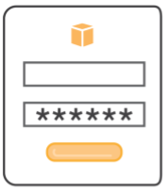
Kontrol dan Manajemen Akses
Identity and Access Management (IAM)
Otentikasi multi-faktor (MFA)
Integrasi dan federasi dengan direktori perusahaan
Amazon Cognito
Masuk AWS Single
Notes:
IAM adalah fitur akun AWS yang ditawarkan tanpa dikenai biaya tambahan. Anda akan dikenai biaya hanya untuk penggunaan layanan AWS lain oleh pengguna

Slide 18

AWS Marketplace
Mitra yang memenuhi syarat untuk memasarkan / menjual perangkat lunak kepada pelanggan AWS
Toko perangkat lunak online yang dapat berjalan di AWS

Slide 19

The AWS Shared Responsibility Model

Slide 20
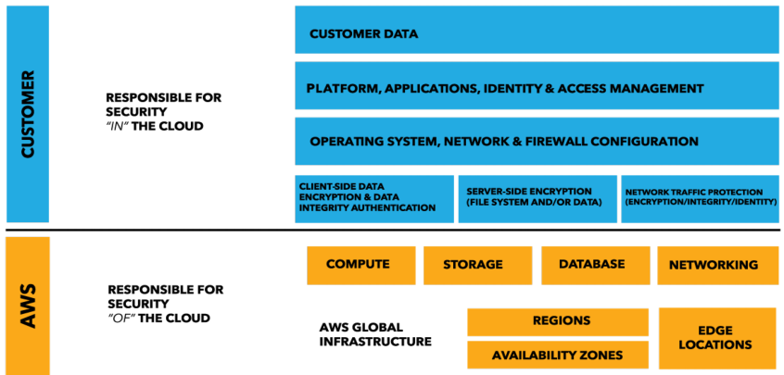
Model Tanggung Jawab Bersama
Notes:
Tanggung jawab AWS "Keamanan Cloud" - AWS bertanggung jawab untuk melindungi infrastruktur yang menjalankan semua layanan yang ditawarkan di AWS Cloud. Infrastruktur ini terdiri dari perangkat keras, perangkat lunak, jaringan, dan fasilitas yang menjalankan layanan AWS Cloud.

Slide 21
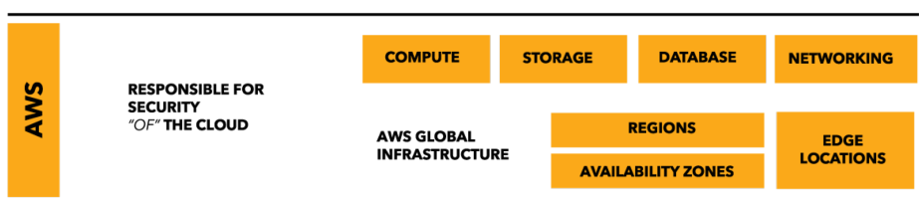
Keamanan Cloud
Perlindungan infrastruktur global AWS adalah prioritas utama
Ketersediaan laporan pihak ketiga

Slide 22
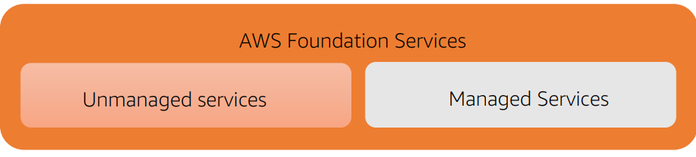
Keamanan Cloud
Amazon EC2
Amazon EBS
Amazon DynamoDB
Amazon RDS
Amazon Redshift
Amazon EMR
Amazon WorkSpaces

Slide 23
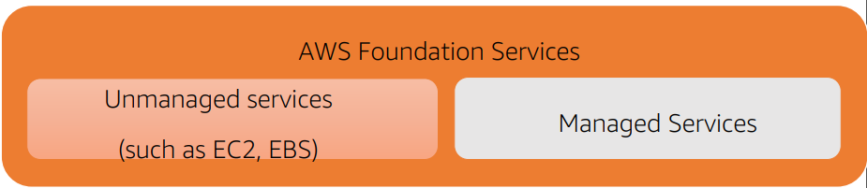
Keamanan Cloud
Kontrol yang Diwarisi
Fisik
Lingkungan
Kontrol Bersama
Manajemen
Manajemen konfigurasi
Kesadaran dan pelatihan
Kasus Pelangan
Layanan / Komunikasi
Perlindungan
Keamanan Zona

Slide 24
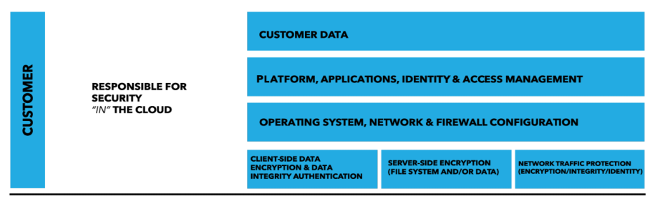
Keamanan Cloud
What to store
Which AWS services
In what location
In what content format and structure
Who has access

Slide 25
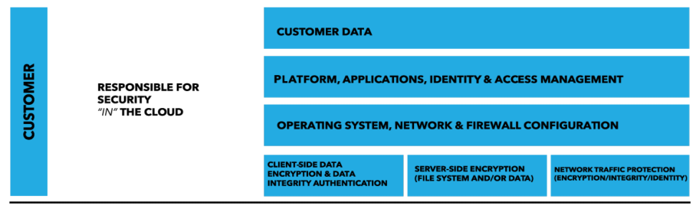
Keamanan Cloud
Pelanggan tetap memegang kendali
Perubahan pada model tergantung pada layanan.

Slide 26
Keamanan Cloud
Layanan AWS
Virtual Machine
Images Servers
Software
Databases

Slide 27
Keamanan Cloud
Manfaat
Mengelola layanan TI umum secara terpusat
Mencapai pemerintahan yang konsisten
Memenuhi persyaratan kepatuhan Cepat
menyebarkan layanan TI yang disetujui

Slide 28
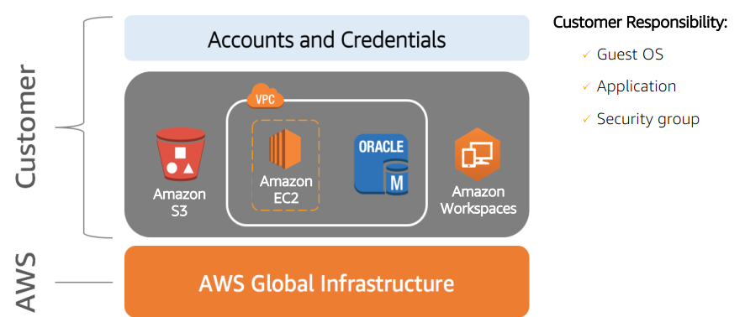
Contoh
Customer Responsibility:
Guest OS
Application
Security group

Slide 29
Kesimpulan
AWS dan pelanggan berbagi tanggung jawab keamanan AWS:
AWS: Security of the cloud
Customer: Security in the cloud
Pelanggan tetap memiliki kendali penuh atas langkah-langkah keamanan
Pelanggan dapat menggunakan
Layanan AWS Layanan "Infrastruktur"

Slide 30
AWS Access Control and
Management

Slide 31

AWS IAM
Control access to AWS resources
Authentication: cek keaslian/kebenaran user access
Authorization: ijin/boleh-tidaknya mengakses
Controls access to services such as:
Compute
Storage
Database
Application services
Notes:
AWS Identity and Access Management (IAM) memungkinkan Anda mengelola akses layanan AWS dan sumber daya secara aman. Dengan menggunakan IAM, Anda dapat membuat dan mengelola pengguna dan kelompok AWS, dan menggunakan izin untuk memperbolehkan atau menolak akses mereka ke sumber daya AWS.
IAM adalah fitur akun AWS yang ditawarkan tanpa dikenai biaya tambahan. Anda akan dikenai biaya hanya untuk penggunaan layanan AWS lain oleh pengguna Anda.
Untuk memulai IAM, atau jika Anda sudah mendaftar AWS, pergi ke AWS Management Console dan mulai dengan IAM Best Practices.

Slide 32

IAM Users Access
AWS Identity Access Management allows to establish access rules and permissions to specific users and applications.
Set up permissions for users and applications
Create user groups for common rules assignment
Cloud Trail allows to monitor the access
Identity federation: allow users to log in with their company credentials
Temporary security credentials, obtained by calling AWS STS APIs like AssumeRole or GetFederationToken

Slide 33
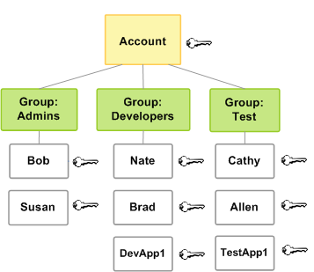
IAM Users Access: Options and Terms
IAM policy - a document that defines the effect, actions, resources, and optional conditions
IAM role – an identity with permission policies, to which users can be assigned
IAM group – a group of users to which common policies can be attached
Minimize the use of the root account
Create Individual users with least privileges. Use MFA
Use AWS Defined policies
Use groups
Use access levels to review IAM permissions
Use roles for applications that run on EC2 instances
Rotate credentials
Best Practices

Slide 34
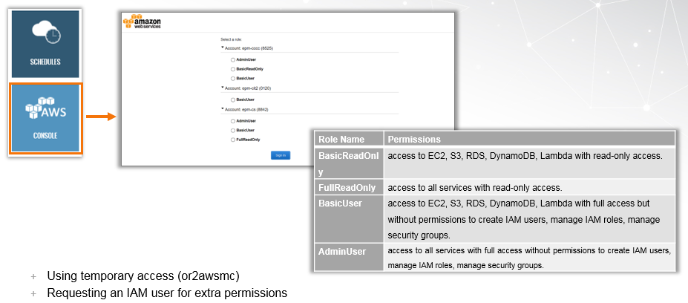
IAM Users Access: EPAM SSO

Slide 35
Assigning IAM Roles to EC2 Instances
Assigning a role to an instance allows to specify the actions that can be performed from this instance to other AWS Services, without need to pass credentials via your application.
VS

Slide 36
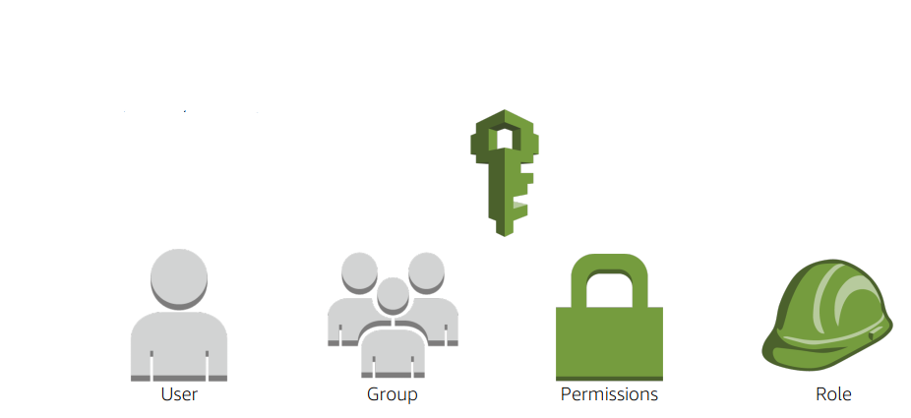
AWS IAM
Create users and groups
Grant permissions

Slide 37

AWS IAM
Functionality
Manage
Users and their access
Roles and their permissions
Federate users and their permissions

Slide 38
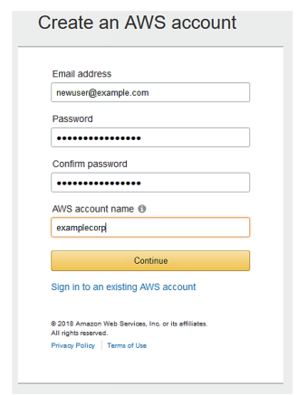
AWS Account Root User
Account root user has complete access to all AWS Services.

Slide 39
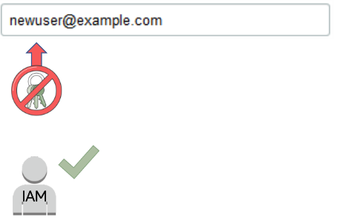
AWS Account Root User
Recommendations
Delete root user access keys.
Create an IAM user.
Grant administrator access.
Use IAM credentials to
interact with AWS.

Slide 40
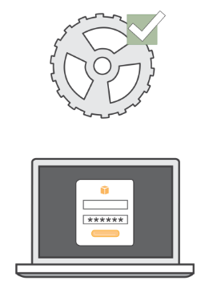
AWS IAM: Authentication
Programmatic access
Enables access key ID and secret access key
Management console access
Uses AWS account name and password
MFA prompts for code

Slide 41

AWS IAM: Authorization
Access AWS services
Grant authorization
Assign permissions
Create an AWS IAM policy

Slide 42
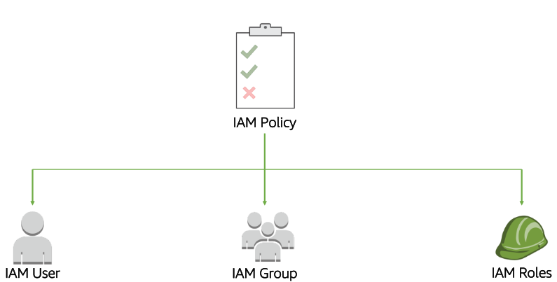
AWS IAM: Policy Assignment

Slide 43
IAM Best Practices
Delete AWS root account access keys
Activate multi-factor authentication (MFA)
Give IAM users only the permissions they must have
Use IAM groups
Apply an IAM password policy

Slide 44
IAM Best Practices
Roles
Use roles for applications
Use roles instead of sharing credentials
Credentials
Rotate credentials regularly
Remove unnecessary users and credentials
Use policy conditions for extra security
Monitor activity in your AWS account

Slide 45
IAM Features
IAM gives you the following features:
Shared access to your AWS account
Granular permissions
Secure access to AWS resources for applications that run on Amazon EC2
Multi-factor authentication (MFA)
Identity federation
Notes:
Shared access to your AWS account
You can grant other people permission to administer and use resources in your AWS account without having to share your password or access key.
Granular permissions
You can grant different permissions to different people for different resources. For example, you might allow some users complete access to Amazon Elastic Compute Cloud (Amazon EC2), Amazon Simple Storage Service (Amazon S3), Amazon DynamoDB, Amazon Redshift, and other AWS services. For other users, you can allow read-only access to just some S3 buckets, or permission to administer just some EC2 instances, or to access your billing information but nothing else.
Secure access to AWS resources for applications that run on Amazon EC2
You can use IAM features to securely provide credentials for applications that run on EC2 instances. These credentials provide permissions for your application to access other AWS resources. Examples include S3 buckets and DynamoDB tables.
Multi-factor authentication (MFA)
You can add two-factor authentication to your account and to individual users for extra security. With MFA you or your users must provide not only a password or access key to work with your account, but also a code from a specially configured device.
Identity federation
You can allow users who already have passwords elsewhere—for example, in your corporate network or with an internet identity provider—to get temporary access to your AWS account.

Slide 46
IAM Features
IAM gives you the following features:
Identity information for assurance
PCI DSS Compliance
Integrated with many AWS services
Eventually Consistent
Free to use
Notes:
Identity information for assurance
If you use AWS CloudTrail, you receive log records that include information about those who made requests for resources in your account. That information is based on IAM identities.
PCI DSS Compliance
IAM supports the processing, storage, and transmission of credit card data by a merchant or service provider, and has been validated as being compliant with Payment Card Industry (PCI) Data Security Standard (DSS). For more information about PCI DSS, including how to request a copy of the AWS PCI Compliance Package, see PCI DSS Level 1.
Integrated with many AWS services
For a list of AWS services that work with IAM, see AWS Services That Work with IAM (p. 521).
Eventually Consistent
IAM, like many other AWS services, is eventually consistent. IAM achieves high availability by replicating data across multiple servers within Amazon's data centers around the world. If a request to change some data is successful, the change is committed and safely stored. However, the change must be replicated across IAM, which can take some time. Such changes include creating or updating users, groups, roles, or policies. We recommend that you do not include such IAM changes in the critical, high-availability code paths of your application. Instead, make IAM changes in a separate initialization or setup routine that you run less frequently. Also, be sure to verify that the changes have been propagated before production workflows depend on them. For more information, see Changes That I Make Are Not Always Immediately Visible (p. 484).
Free to use
AWS Identity and Access Management (IAM) and AWS Security Token Service (AWS STS) are features of your AWS account offered at no additional charge. You are charged only when you access other AWS services using your IAM users or AWS STS temporary security credentials. For information about the pricing of other AWS products, see the Amazon Web Services pricing page.

Slide 47
Understanding How IAM Works
The IAM infrastructure includes the following elements:
Topics:
Terms
Principal
Request
Authentication
Authorization
Actions or Operations
Resources
Notes:
Before you create users, you should understand how IAM works. IAM provides the infrastructure necessary to control authentication and authorization for your account.

Slide 48
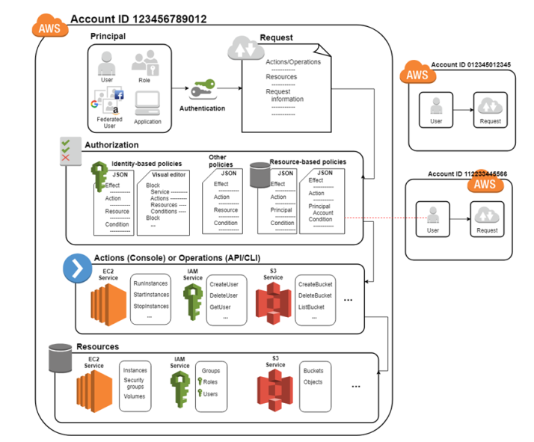

Slide 49

AWS Security Compliance
Programs

Slide 50
Overview
AWS compliance approach
AWS risk and compliance programs
AWS customer compliance responsibilities

Slide 51

AWS Compliance Approach
AWS and customers share control
AWS responsibility
Provide highly secure and controlled platform
Provide wide array of security features
Customers responsibility
Configure IT

Slide 52
AWS Security Information
AWS shares security information by
Obtaining industry certifications
Publishing security and control practices
Compliance report directly under NDA

Slide 53
Assurance Programs
AWS, certifying bodies, and independent auditors Provide:
Certifications and attestations
Laws, regulations, and privacy
Alignments and frameworks

Slide 54

AWS Risk and Compliance Programs
AWS risk and compliance programs
Provide information about AWS controls
Assist customers in documenting their
framework

Slide 55
AWS Risk and Compliance Programs
Components of AWS Risk and Compliance Programs
Risk management
Control environment
Information security

Slide 56
Risk Management
AWS management
Business plan
Includes risk management
Re-evaluated at least biannually
Responsibilities
Identifies risks
Implements appropriate measures
Assesses various internal/external risks

Slide 57

Risk Management
Information security network is based on
Control Objectives for Information and related Technology (COBIT)
American Institute of Certified Public Accountants (AICPA)
National Institute of Standards and Technology (NIST)

Slide 58
Risk Management
AWS
Maintains the security policy
Provides security training to employees
Performs application security reviews
Confidentiality
Integrity
Availability of data
Conformance to IS policy

Slide 59
Risk Management
AWS security
Scan service endpoints for
vulnerabilities
Notifies for remediation of
vulnerabilities
Independent security firms
Scans are not a replacement for customer scans
Customers can request to scan cloud infrastructure

Slide 60
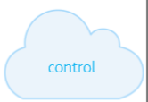
Control Environment
Includes policies, processes, control activities
Secure delivery of AWS’ service offerings
Supports the operating effectiveness of AWS’ control framework
Integrates controls
Monitors for leading practices
Notes:
Termasuk kebijakan, proses, kegiatan kontrol Pengiriman aman penawaran layanan AWS Mendukung efektivitas operasi kerangka kontrol AWS Mengintegrasikan kontrol Monitor untuk praktik kerja unggulan

Slide 61
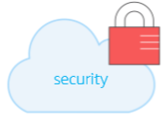
Information Security
Designed to protect
Confidentiality
Integrity
Availability
Publishes security whitepaper

Slide 62
Customer Compliance
Customer requirements
Maintain governance over the entire IT control environment
Understand
Required compliance objectives
Validation based risk tolerance
Establish control environment
Verify effectiveness of control environment

Slide 63
Summary
AWS security compliance programs
Enables customers to understand robust controls to maintain security and data protection
Shared compliance responsibilities

Slide 64
LATIHAN

Slide 66





IKUTI KAMI
digitalent.kominfo
digitalent.kominfo
DTS_kominfo
Digital Talent Scholarship 2019
Pusat Pengembangan Profesi dan Sertifikasi
Badan Penelitian dan Pengembangan SDM
Kementerian Komunikasi dan Informatika
Jl. Medan Merdeka Barat No. 9
(Gd. Belakang Lt. 4 - 5)
Jakarta Pusat, 10110
digitalent.kominfo.go.id

